Slide 1

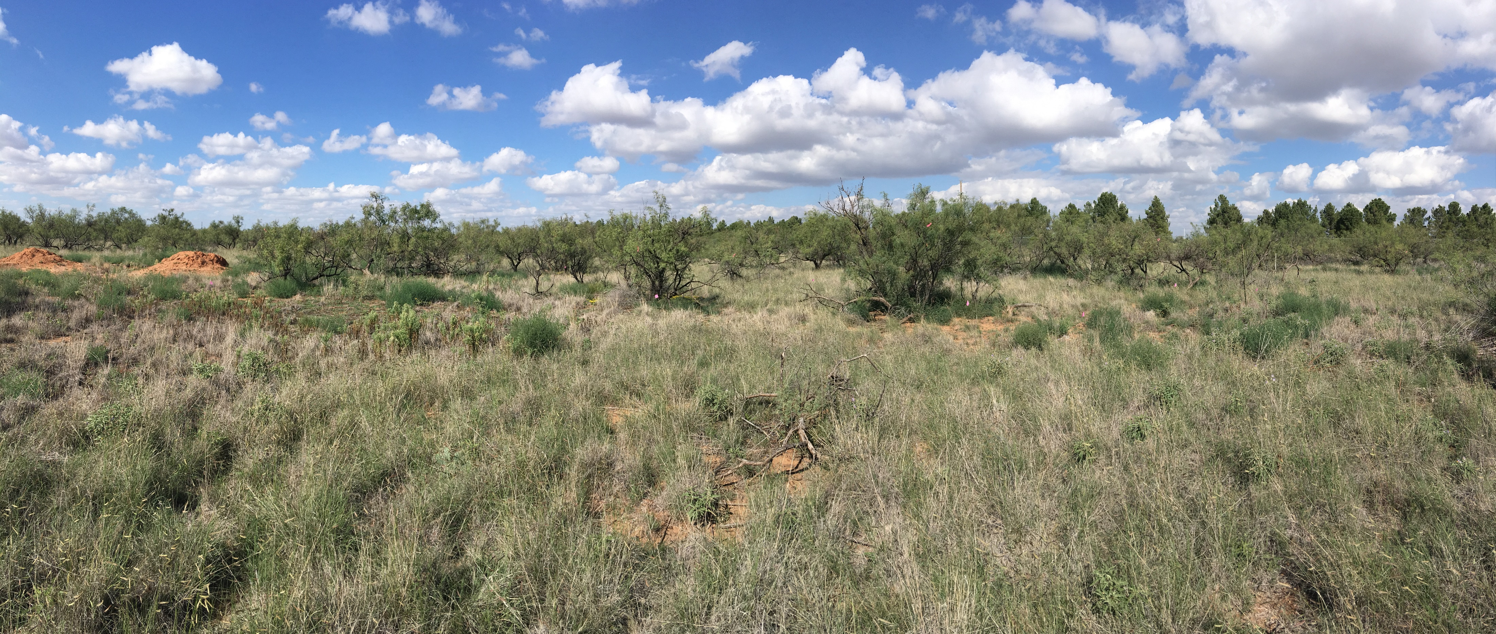
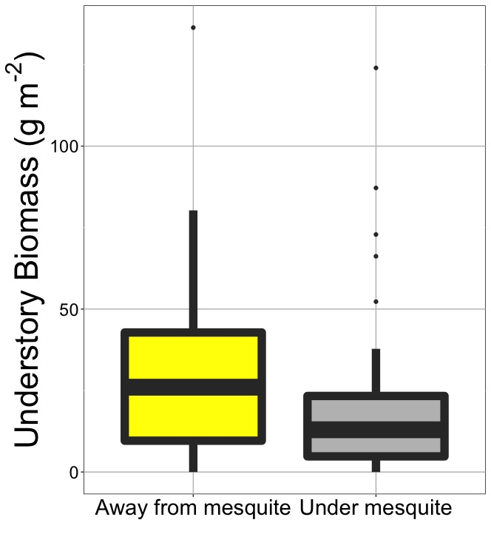
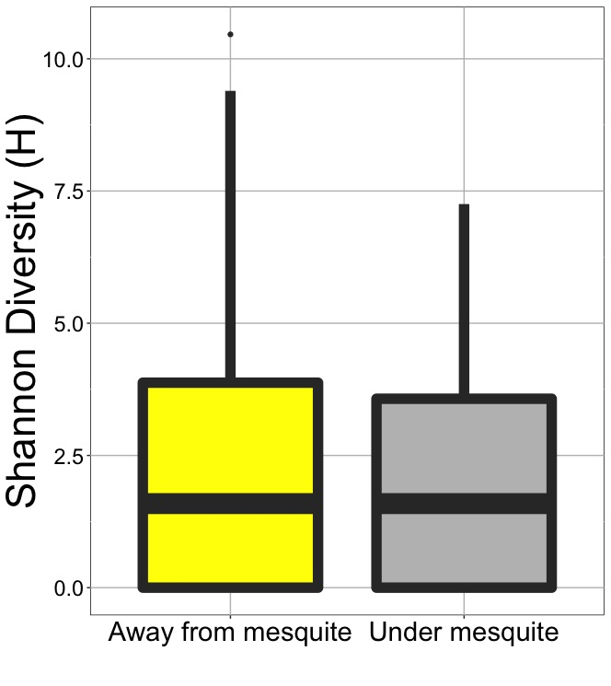
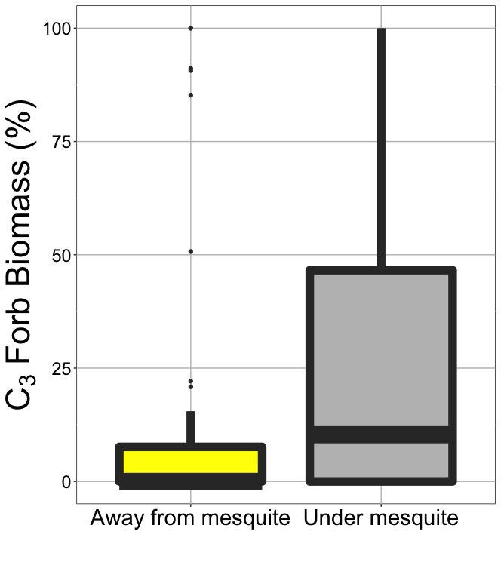
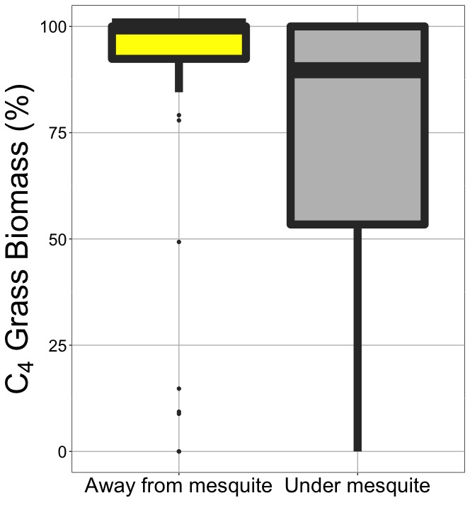
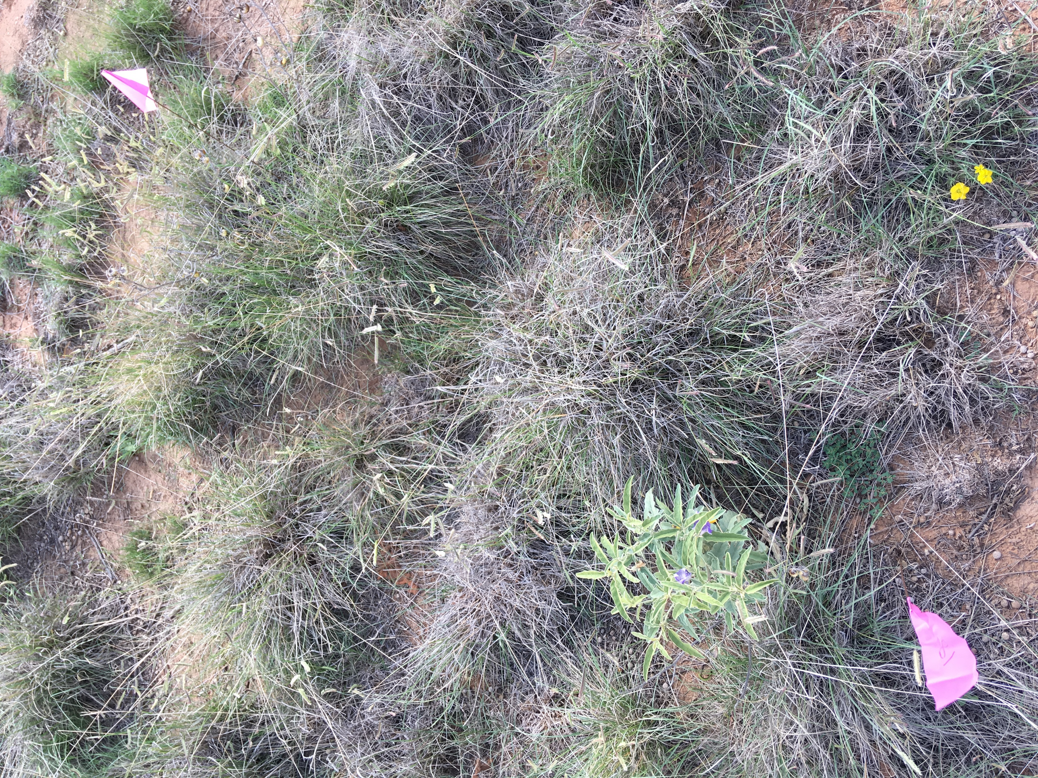
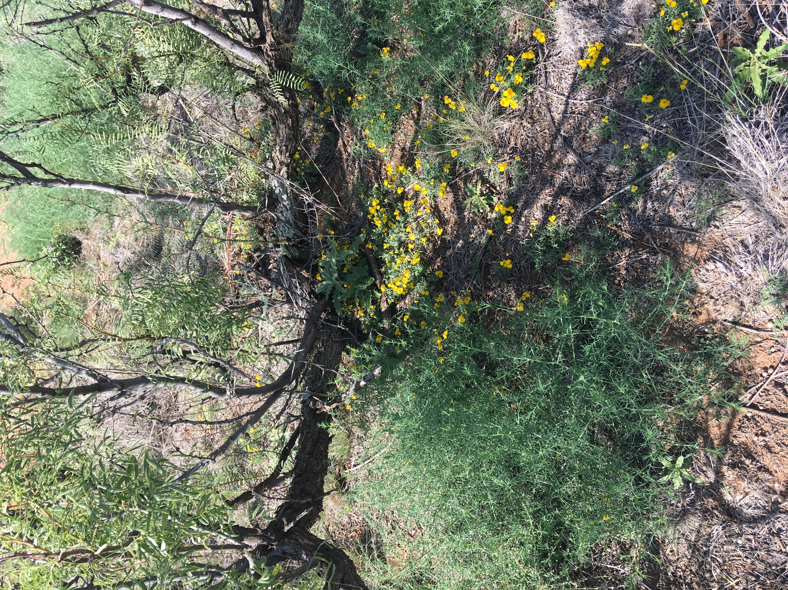
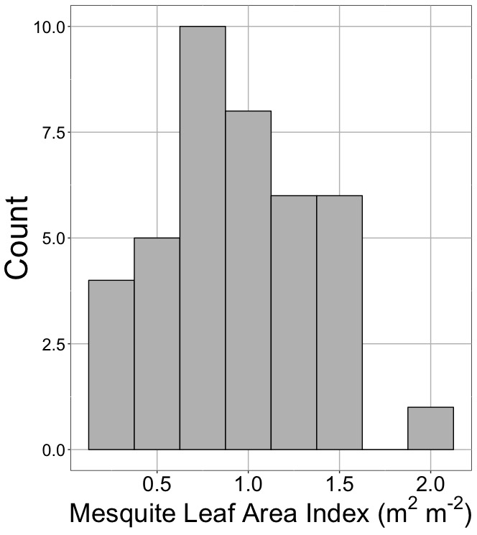
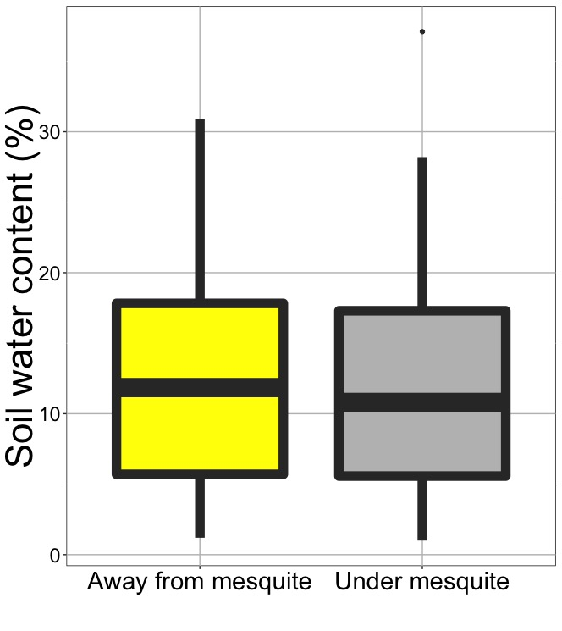
Mesquite alters community structure,
but not diversity in shortgrass prairie
Poster available at: bit.ly/2Ya7ZS6
Leah Ortiz & Nick Smith*
Texas Tech University, Department of Biological Sciences
*nick.smith@ttu.edu; @nick_greg_smith
Mesquite: an invasive species in southwestern grasslands
Mesquite reduced understory; had no effect on diversity…
…but favored C₃ forbs and reduced C₄ grasses
P < 0.05
P > 0.05
P < 0.05
In Texas, mesquite cover is increasing at 2.2% per year
Little is known about the ecosystem impact
P < 0.05
Mechanism: decreased light availability and soil moisture
What does this mean for the system moving forward?
Methods
Outside mesquite
Under mesquite
More total productivity (mesquite: >800 g m⁻²)
No loss in plant diversity
A whole new community of plants
Cascading effects?
P < 0.05
40 paired rangeland plots
Plant community: biomass and community composition
Microhabitat: soil moisture
Does mesquite-driven changes in microhabitat influence short-grass prairie communities?
What are the mechanisms driving this change?
What do these effects mean for the grassland ecosystems moving forward?
plant diversity was unaffected by the mesquite presence, but that the non-mesquite communities were not made up of similar species.
18% greater grass to forb biomass ratio in the plots outside the canopy than those under the canopy.
Results suggest that with the invasion of the of the honey mesquite tree, the grassland community structure may become more productive overall without a loss in total diversity, but the species comprising the plant community will not resemble the pre-invasion community.

